Slide 1


Automated Story Generator (in code dictionary)
Sanyam Jain 500046658 Roll number 41
Sonaal Kalra 500046848 Roll number 45
Shivani Sharma 500046544 Roll number 57
Date : August 25,2017
Under the Guidance of Dr. Hitesh Kumar Sharma

Slide 2
Abstract
Previous work in the field of automatic story-generation has largely neglected reader-response as an important aspect of the success of a story. The first story generator was made in 1990s, TALESPIN by Meehan written in LISP. From then it is the topic of interest in various AI and ML researchers to make a system which generates some sensible and meaningful stories. Recent work was made in 2016 using JavaScript by Stanford and CMU Pittsburgh.

Slide 3
Introduction
The automated story generator is the basic model for the current working large scale models for plot generators on the internet. The current working of those generators collectively work on principle of SGA(story Generator Algorithms). SGAs are classified to make random stories or user suggested ones. We’ll use the former algo. Also the stories are more genre specific. Here, We try to generate domain specific stories. For eg : Horror, Romantic etc.

Slide 4
Introduction
So, We try to make our Generator more Genre specific and precise, ASG also randomize each plot so that the user will not get the same content again and again.
So to approach an accounting of general storiness, it seems useful to focus on the point of interaction between story and reader, to consider what a story does to a reader, rather than its intrinsic structure or content.
The product of generation is a logical representation of the plot of a story, composed of a sequence of logical assertions about events and characters within the story-world.

Slide 5
Problem statement
Thinking about some stories and mind but not able to make or complete it
Making any random content or write any content just by having keywords is not easy
Content generation automatically is very diffuicult and always been very hot topic since 60s.
Having only the keywords and generate any random plot is not easy
Writing papers , genre specific content , Narrating, Natural language generation are major aspects of AI.

Slide 6
Literature
A story generator or plot generator is a tool that generates basic narratives or plot ideas. The generator could be in the form of a computer program, a chart with multiple columns, a book composed of panels that flip independently of one another, or a set of several adjacent reels that spin independently of one another, allowing a user to select elements of a narrative plot. The tool may allow the user to select elements for the narrative, or it may combine them randomly, a specific variation known as a random plot generator. Such tools can be created for virtually any genre, although they tend to produce formulaic and hackneyed situations.

Slide 7
Objective
Objective is to make a Automated story generator using some predefines Subject+verb+object. The mathematics of English sentence is the grammar. We try to make our program learn for the Grammar syntaxes for some genre specific generation. User may or may not need to give genre for this automation.
Objective is to produce original and random content each time. And in very less time. Also it is very first try to make ASG using C language, need to embed several libraries available for word parsing, word predictions,grammar libraries, word base etc.

Slide 8
Methodology
Existing versions of ASG work on principle of the word data sets, story sets. Our program workflow:
-program will be trained for the keywords, subjects , objects and all real world entities.
-Those keywords are coded such that it makes fresh, real and original content every time.
-Several algorithms for making random generations, string related algorithms, time calculation algorithms etc will be used for making our program more efficient each time of use.

Slide 9
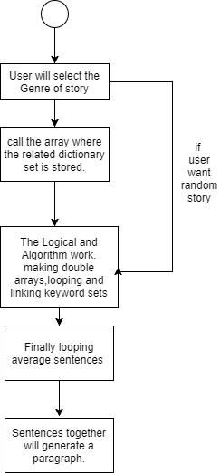
Our Procedure

Slide 10
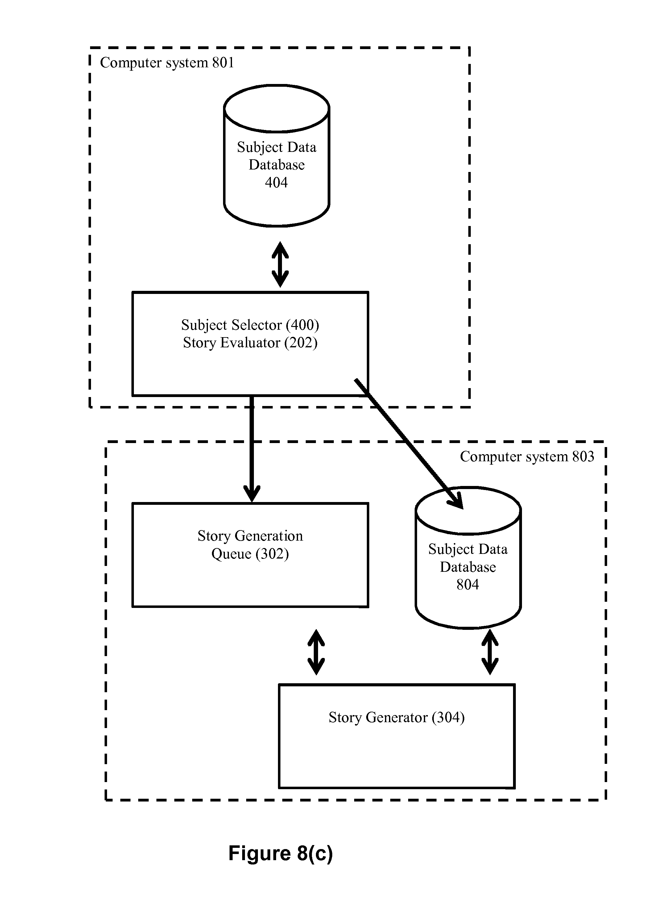
Procedures till now
followed

Slide 11
System Requirements: (we have)
Linux origin OS (our system is Ubuntu 16.04 LTS)
Gcc compiler (sudo apt-get install gcc)
Vim/vi
Stdlib, strings and other header files
And remaining basic requiements.

Slide 12
References
https://ocs.aaai.org/Papers/Symposia/Fall/1999/FS-99-01/FS99-01-027.pdf
http://wikis.sub.uni-hamburg.de/lhn/index.php/Story_Generator_Algorithms
Springer

Slide 13
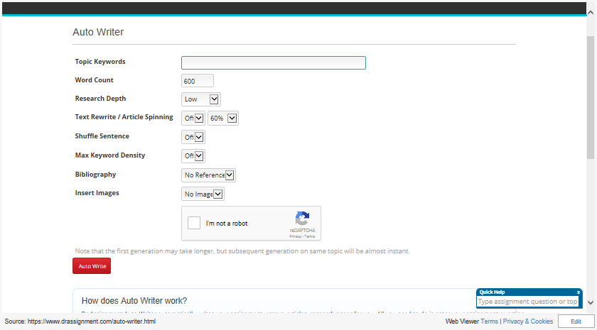

Slide 14
Questions and Answers

